Slide 1
Student Management System
Using Node JS

Slide 2
Project Presentation
Submitted by:
AYUSH DHIMAN(2118392)

Slide 3
Contents
Introduction
Requirement
Features
Entity Relation Model
Decision Tree
Screenshots.
Conclusion

Slide 4
Introduction
About Student Management System
"Student Management System is a solution tool that is designed to track, maintain and manage all the data generated by a School, including the grades of a student, their attendance, their interpersonal activities records, etc.,"

Slide 5
Introduction
About Node JS
Node.js is an open-source, cross-platform, back-end JavaScript runtime environment that runs on the V8 engine and executes JavaScript code outside a web browser.

Slide 6
Requirement
Technology Used:
Front End: HTML, CSS, JavaScript, Handlebars.
Language: Node JS
Back End: MySQL

Slide 7
Requirement
Software configuration:
Operating system: Windows or Linux
Software: Visual studio code
Database: MySQL Database Service
Server: Apache HTTP Server
Hardware Configuration:
Processor: Intel Core i3 processor or higher
Hard Disk: Minimum 4 GB
RAM: 512 MB or more.
Network Connectivity.

Slide 8
FEATURES
Administrator
Login/Logout
Add Student
View Student Information
Edit Student Information
Delete Student Accounts
Search Students

Slide 9
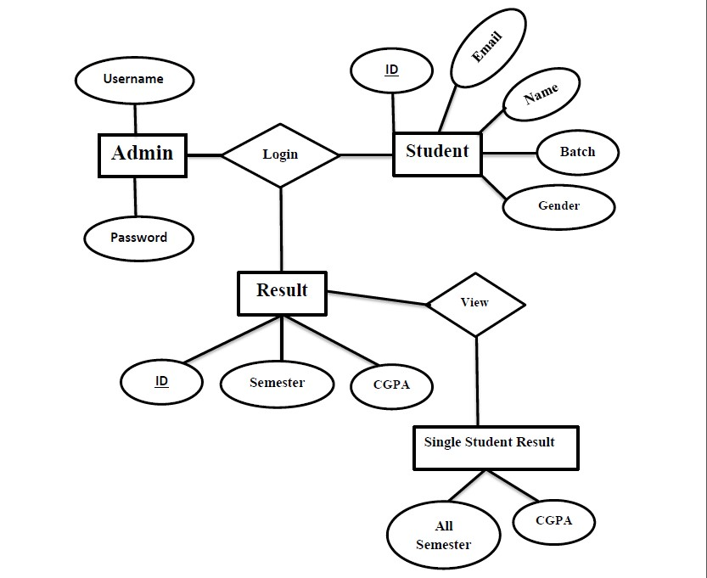
Entity Relation Model

Slide 10
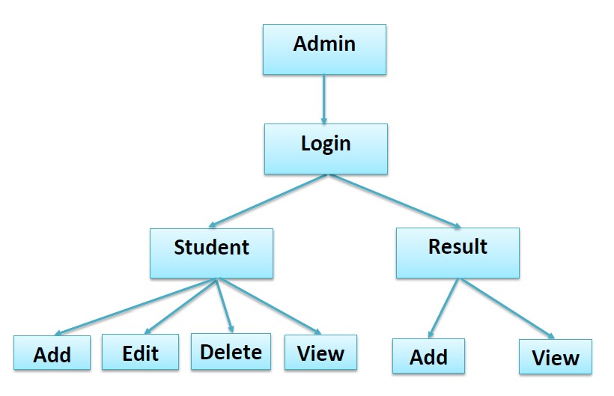
Decision Tree

Slide 11

Screenshots
Login

Slide 12
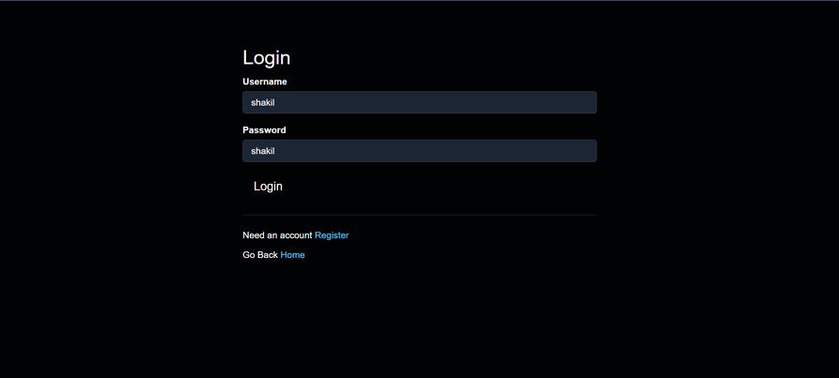
Screenshots
Login

Slide 13
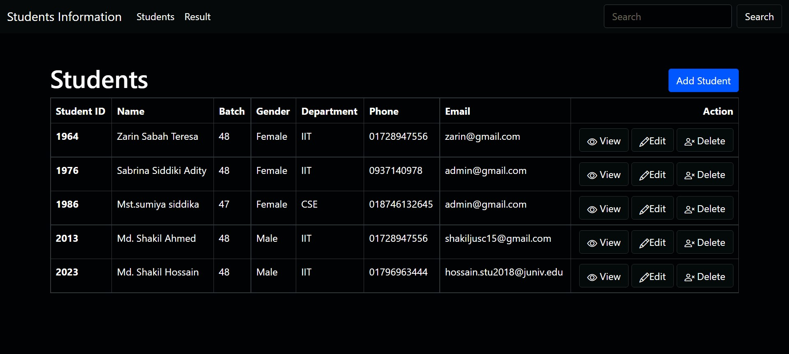
Home

Slide 14
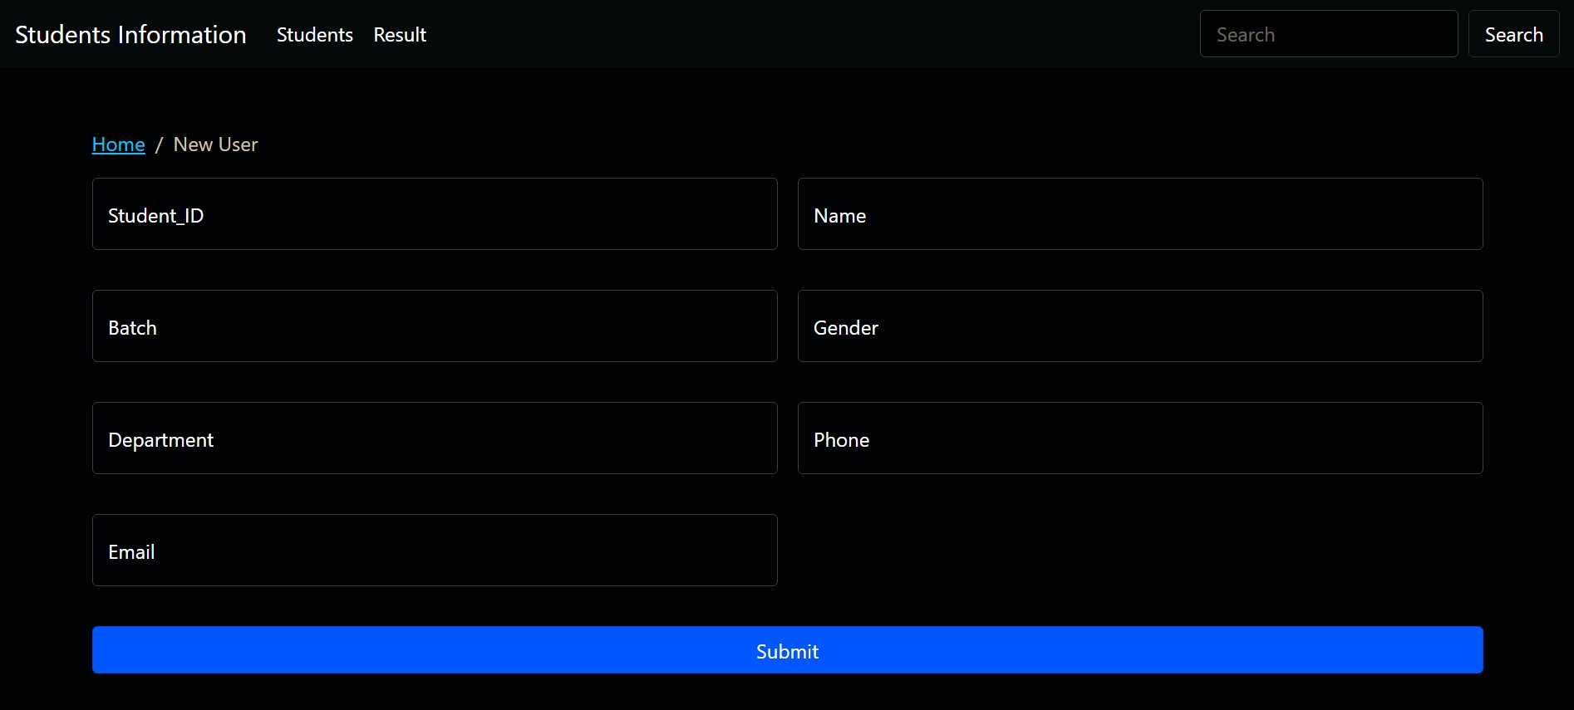
Add Student

Slide 15
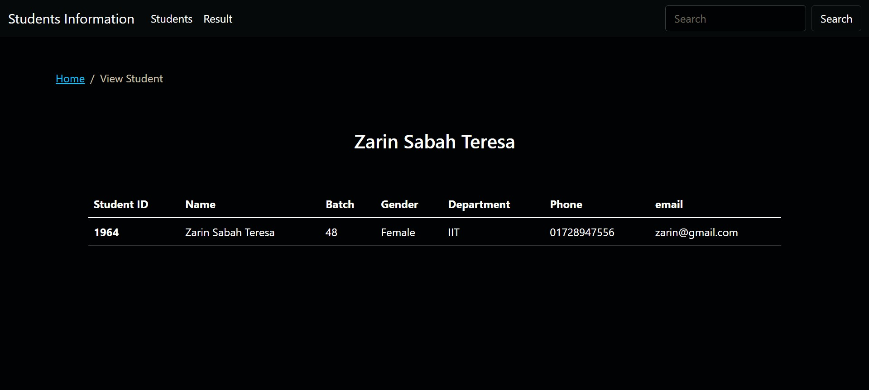
View Student

Slide 16
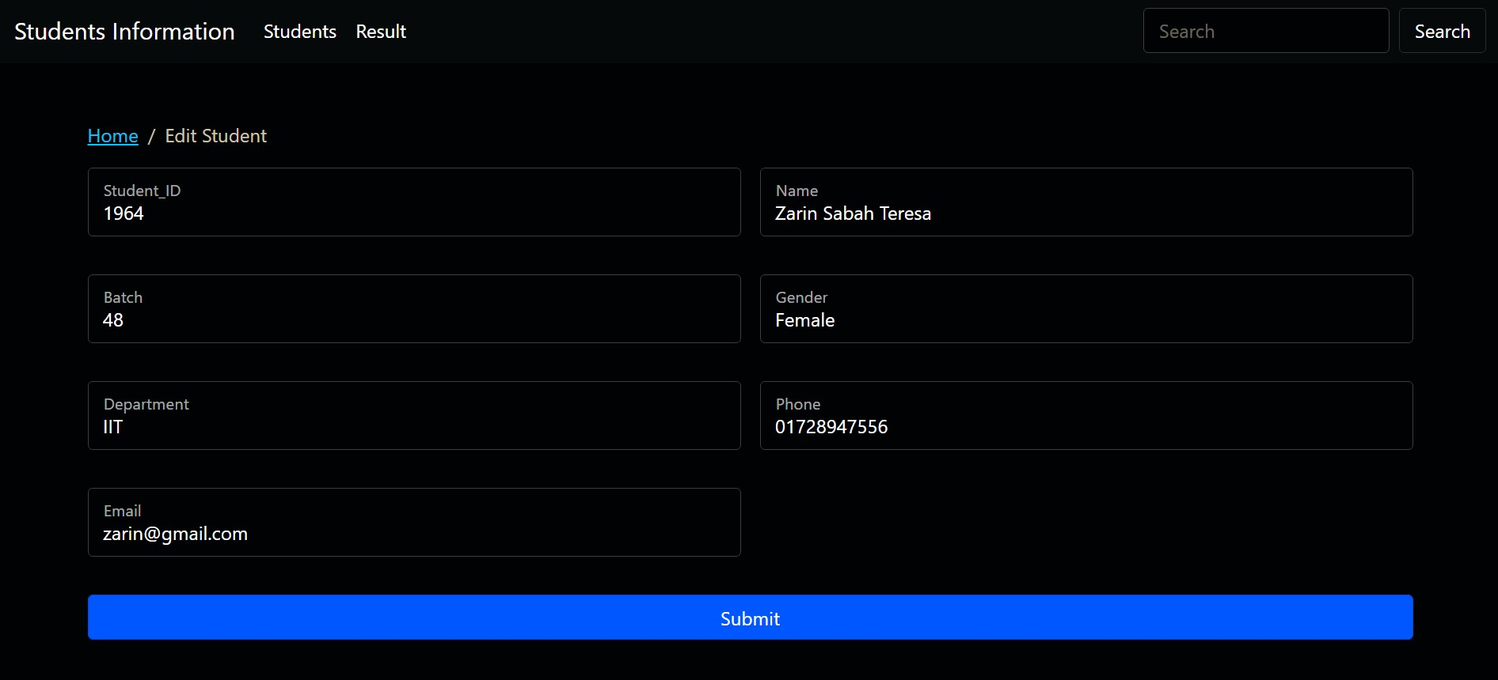
Edit Student

Slide 17
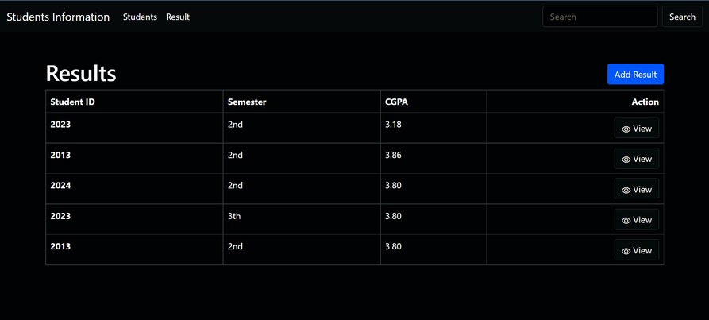
Result

Slide 18
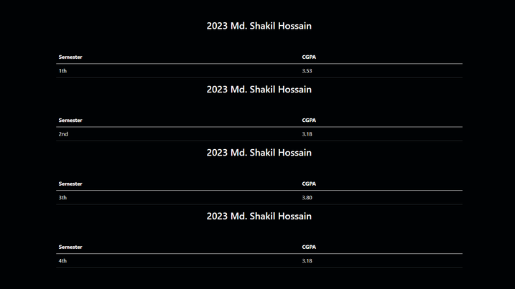
View Results

Slide 19
Conclusion
Student management systems make faculty jobs more accessible by giving them an easy place to find and sort information. This system allows teachers and student managers to follow with their student engagement.

Slide 20
References
https://nodejs.org/en/
www.msdn.microsoft.com
http://sourceforge.net/
http://www.gnu.org
http://www.thefreecountry.com
http://www.1001tutorials.com/

Slide 21
Thank You

